Slide 1

OpenSearch
Garvit Kumar Gupta
Presentation by
Under the guidance of
Mr. Supratim Sen
&
Mr. Sundar Srinivasan

Slide 2


Objective
OpenSearch setup for CSE on
cloud as a replacement for ELK

Slide 3
Agenda
01
OpenSearch
05
File Beat
02
Tenant
06
DashBoard & Visualization
03
Saved Objects
07
Users, Roles &
Mapping
04
Ingest Pipeline
08
Summary

Slide 4

OpenSearch
The Apache 2.0-licensed search,
analytics, and visualization suite with advanced
security, alerting, SQL support, automated index
management, and more
4

Slide 5
Why OpenSearch?
Robust
Security
Highly Scalable
Quickly Deployed
&
Easily Managed
OpenSearch
Open Source
AI Support
Built-in
Integration

Slide 6
Log Analytics
Clickstream
Analytics
OpenSearch
Use Case
Enterprise
Search
Real-Time Application
Monitoring

Slide 7
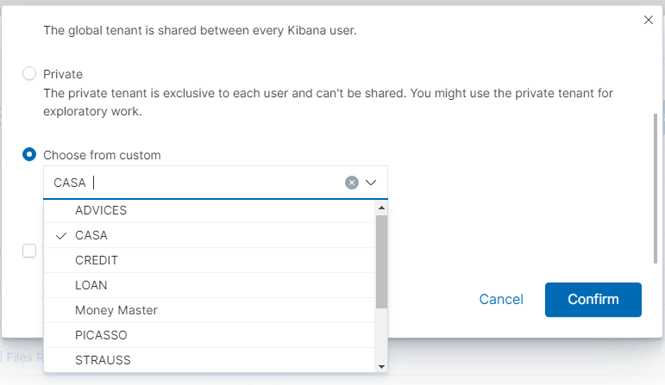
Tenants
Allow us to organize our saved objects into meaningful categories.
Useful for safely sharing our work with other OpenSearch Dashboards users.
Fig: Tenants I created using API (Currently in CASA)
Fig: Tenants I created using API (Currently in CASA)
7

Slide 8
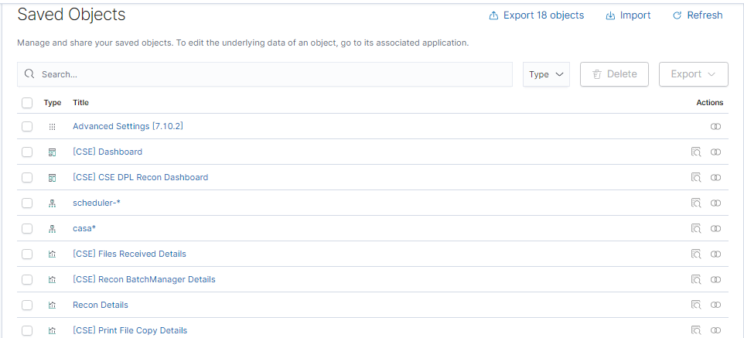
Saved Objects
These objects store data for later use, including dashboards, visualizations, maps, data views, Canvas work pads, and more.
Fig: Saved Objects in CASA Tenant
8

Slide 9
Ingest Pipelines
Incoming
Documents
Grok
Convert
Target Index
Ingest pipelines let us perform common transformations on
our data before indexing. For example, we can use pipelines to remove fields, extract values from text, and enrich your data.

Slide 10
Each processor runs sequentially, making specific changes to incoming documents
After the processors have run, OpenSearch adds the transformed documents to our data stream or index.
Split
Set
Grok
Processors
Convert
Script

Slide 11

FileBeats
A lightweight shipper
monitors
log files
collects
log events
forwards them
to OpenSearch

Slide 12
How to Push logs to OpenSearch
FileBeat
Ingest Pipeline
Input
Filter
Output
OpenSearch

Slide 13
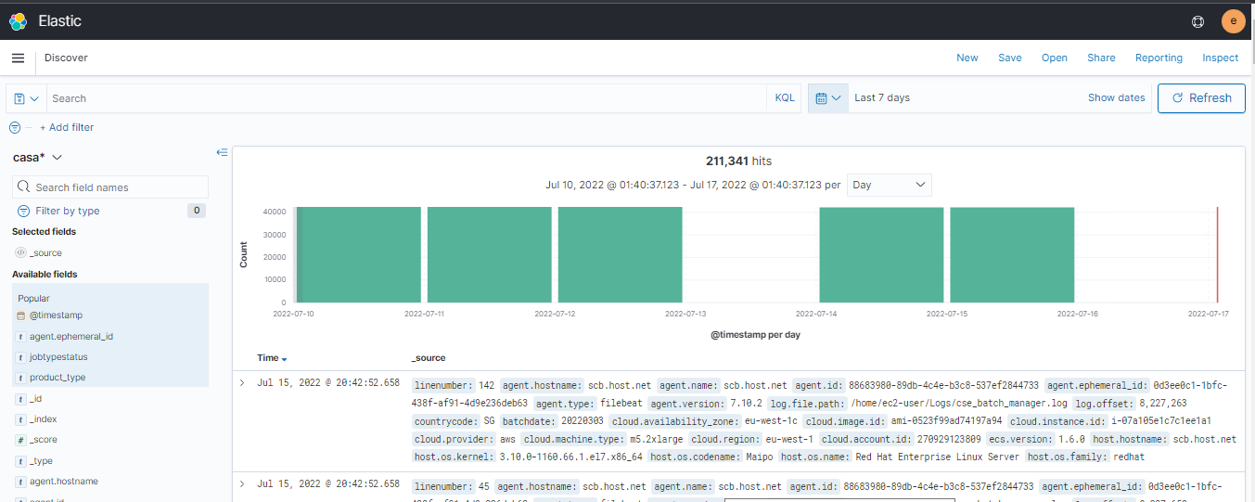
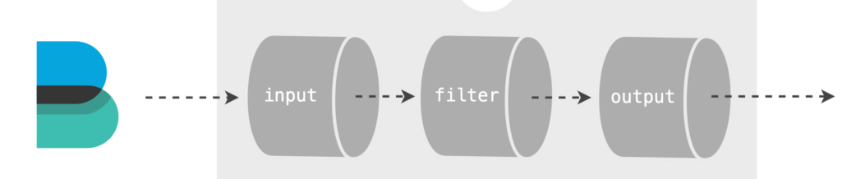
Discover
File Beat
Ingest Pipeline
OpenSearch
13

Slide 14
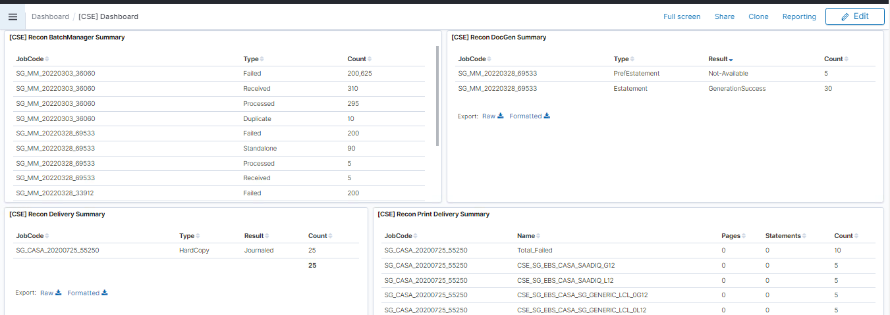
Dashboard
Turn our data from one or more data views into a collection of panels
Bring clarity to our data
Tell a story about our data
Focus on only the important data
Fig: [CSE] Dashboard in CASA Tenant
14

Slide 15
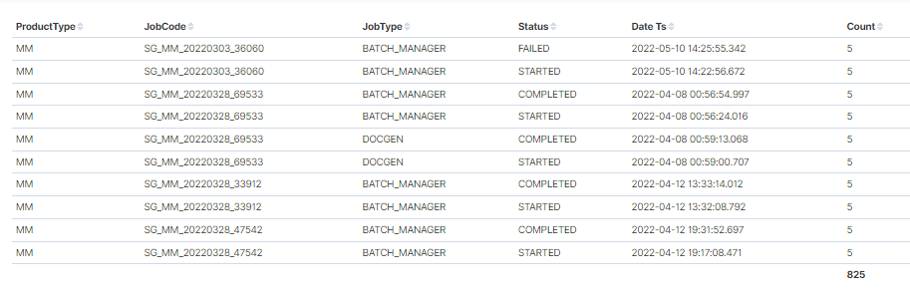
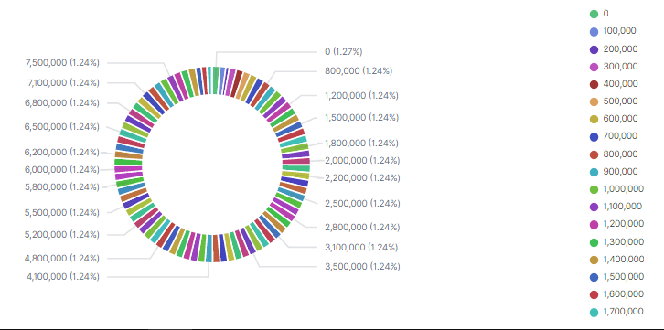
Visualizations
<- Visualization 1
Visualization 2 ->
15

Slide 16
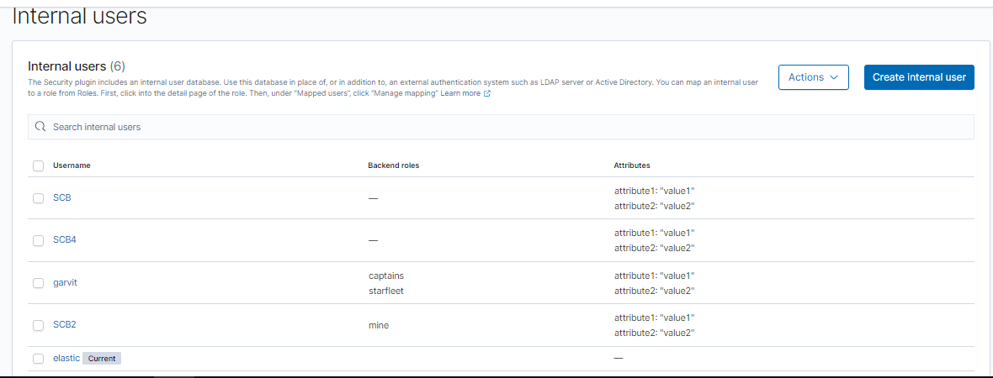
Users
Fig: All internal users (Current user is elastic)
16

Slide 17
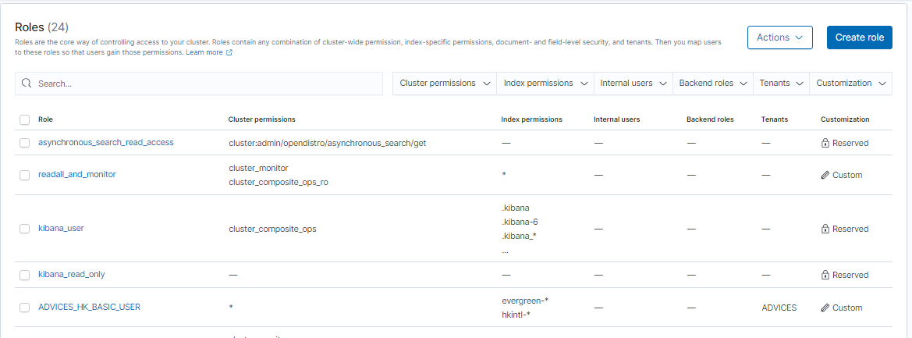
Roles & Roles Mapping
Roles are the core way of controlling access to your cluster.
Roles contain any combination of cluster-wide permissions, index-specific permissions, document- and field-level security, and tenants.
Then we can map users to these roles so that users gain those permissions.
Fig: Roles in OpenSearch
17

Slide 18
Acquiring new tech knowledge quickly
There is no comprehensive explanation for OpenSearch APIs.
Occasional of VDI
VDI Crashes on Occasional Basis
Challenges

Slide 19






Sources & References
19

Slide 20
Summary
OpenSearch has been set up and configured for the CSE cloud as a replacement for the ELK platform.
OpenSearch enables us to easily ingest, secure, search, aggregate, view, and analyze data.
Various tenants and saved objects have been created for this purpose.
Ingest pipelines have been created to preprocess the incoming documents.
Roles have been also mapped to the various users using Open search APIs.

Slide 21
Thankyou

